Slide 1

WEST ORANGE SELF STORAGE | ESSEX COUNTY, NJ
WEST ORANGE SELF STORAGE | IMAGERY
03.25.2021
Louis W Vandeloecht
Architect

Slide 2
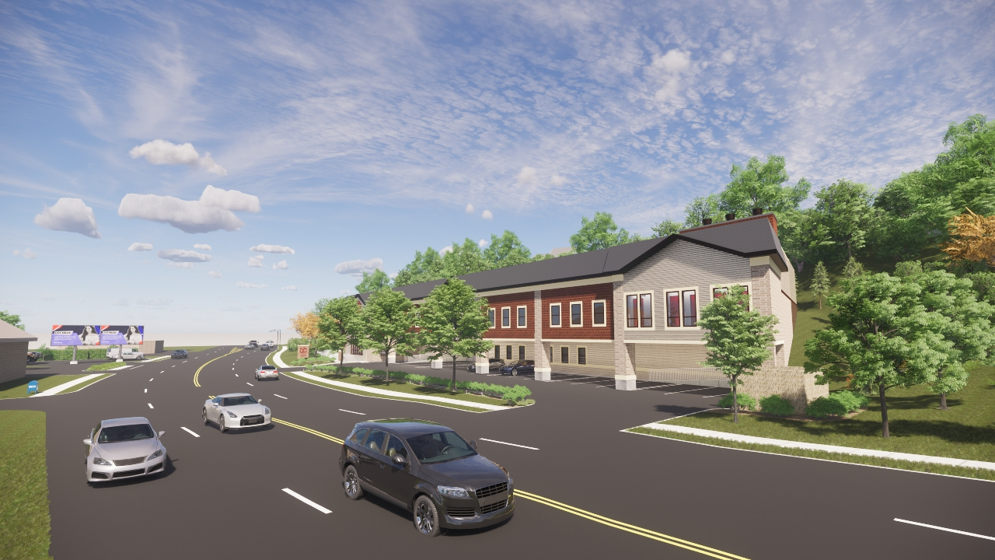
WEST ORANGE SELF STORAGE | ESSEX COUNTY, NJ
IMAGE 1
CONCEPTUAL DRAFT ONLY
Louis W Vandeloecht
Architect

Slide 3
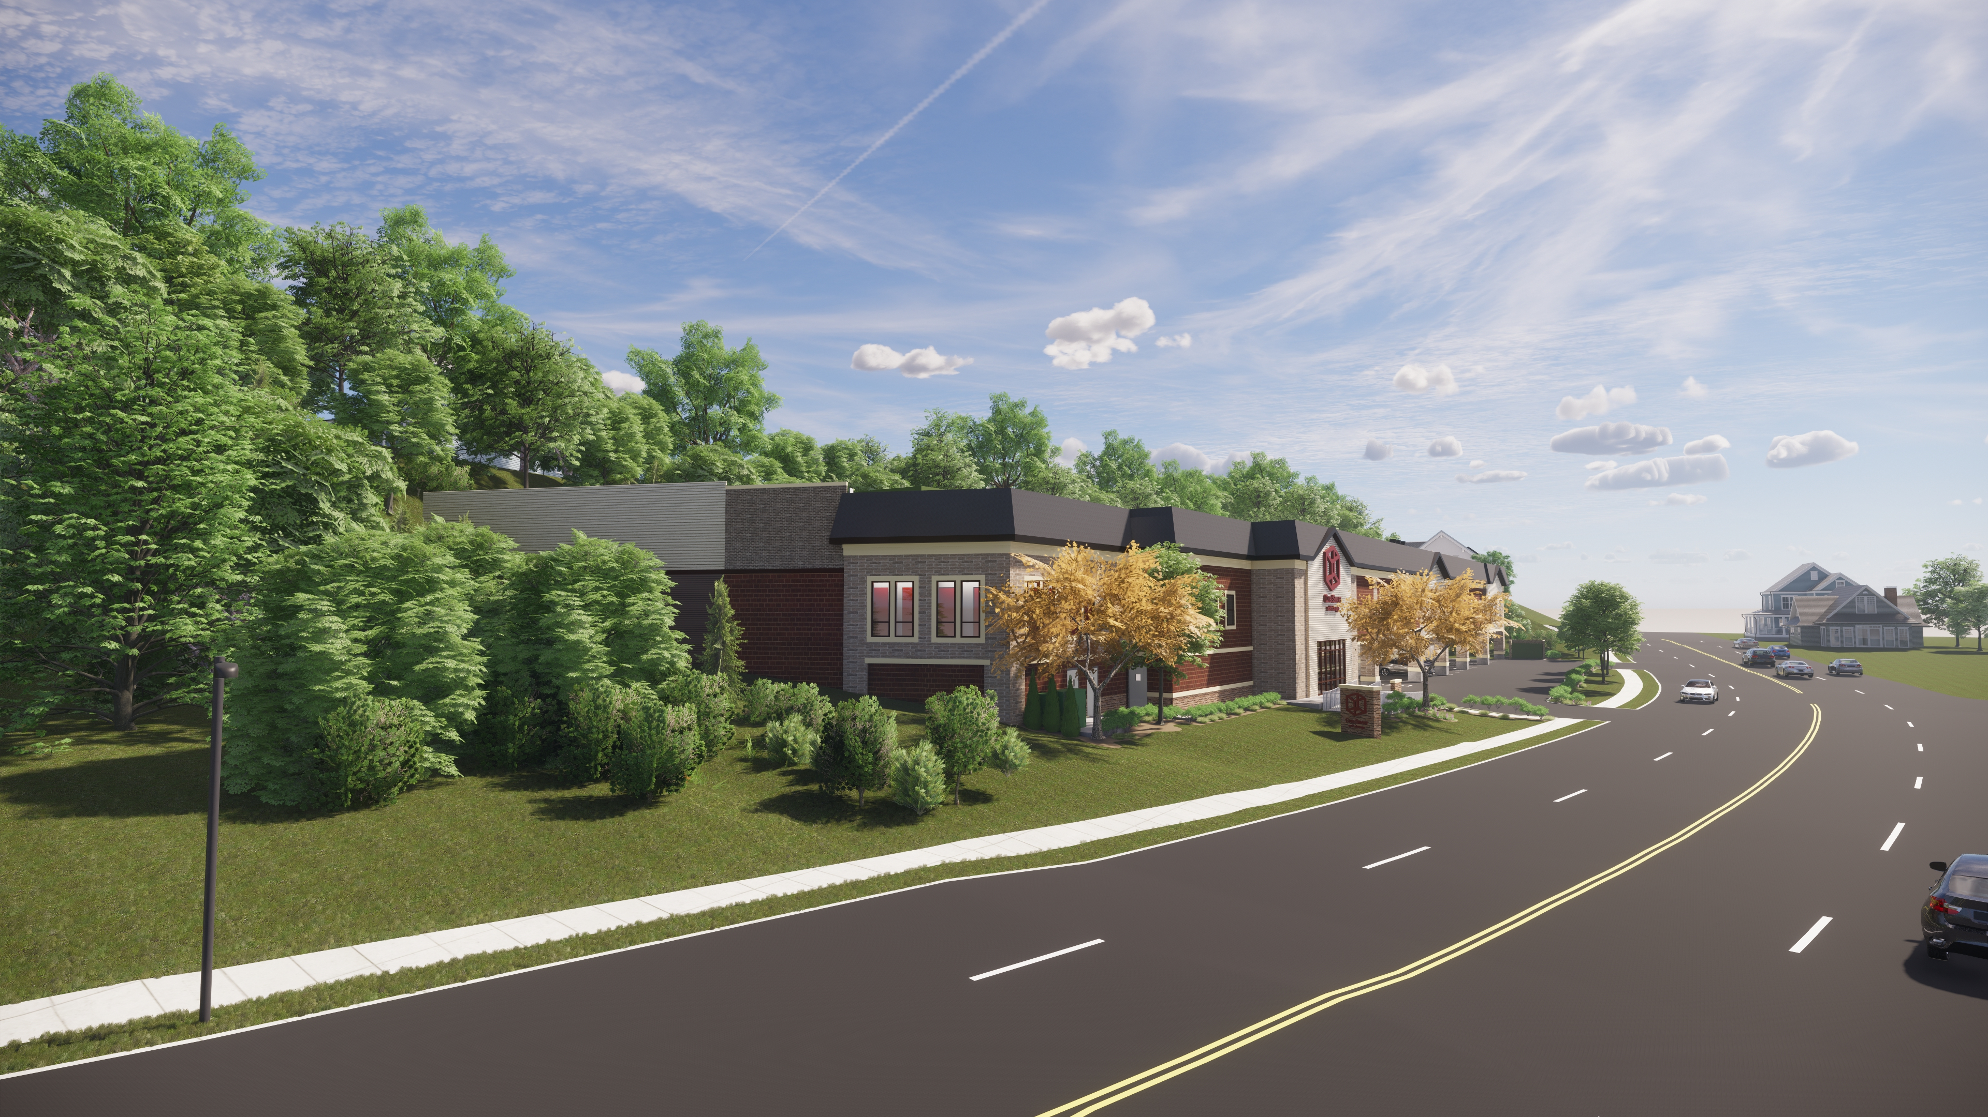
WEST ORANGE SELF STORAGE | ESSEX COUNTY, NJ
IMAGE 2
CONCEPTUAL DRAFT ONLY
Louis W Vandeloecht
Architect

Slide 4
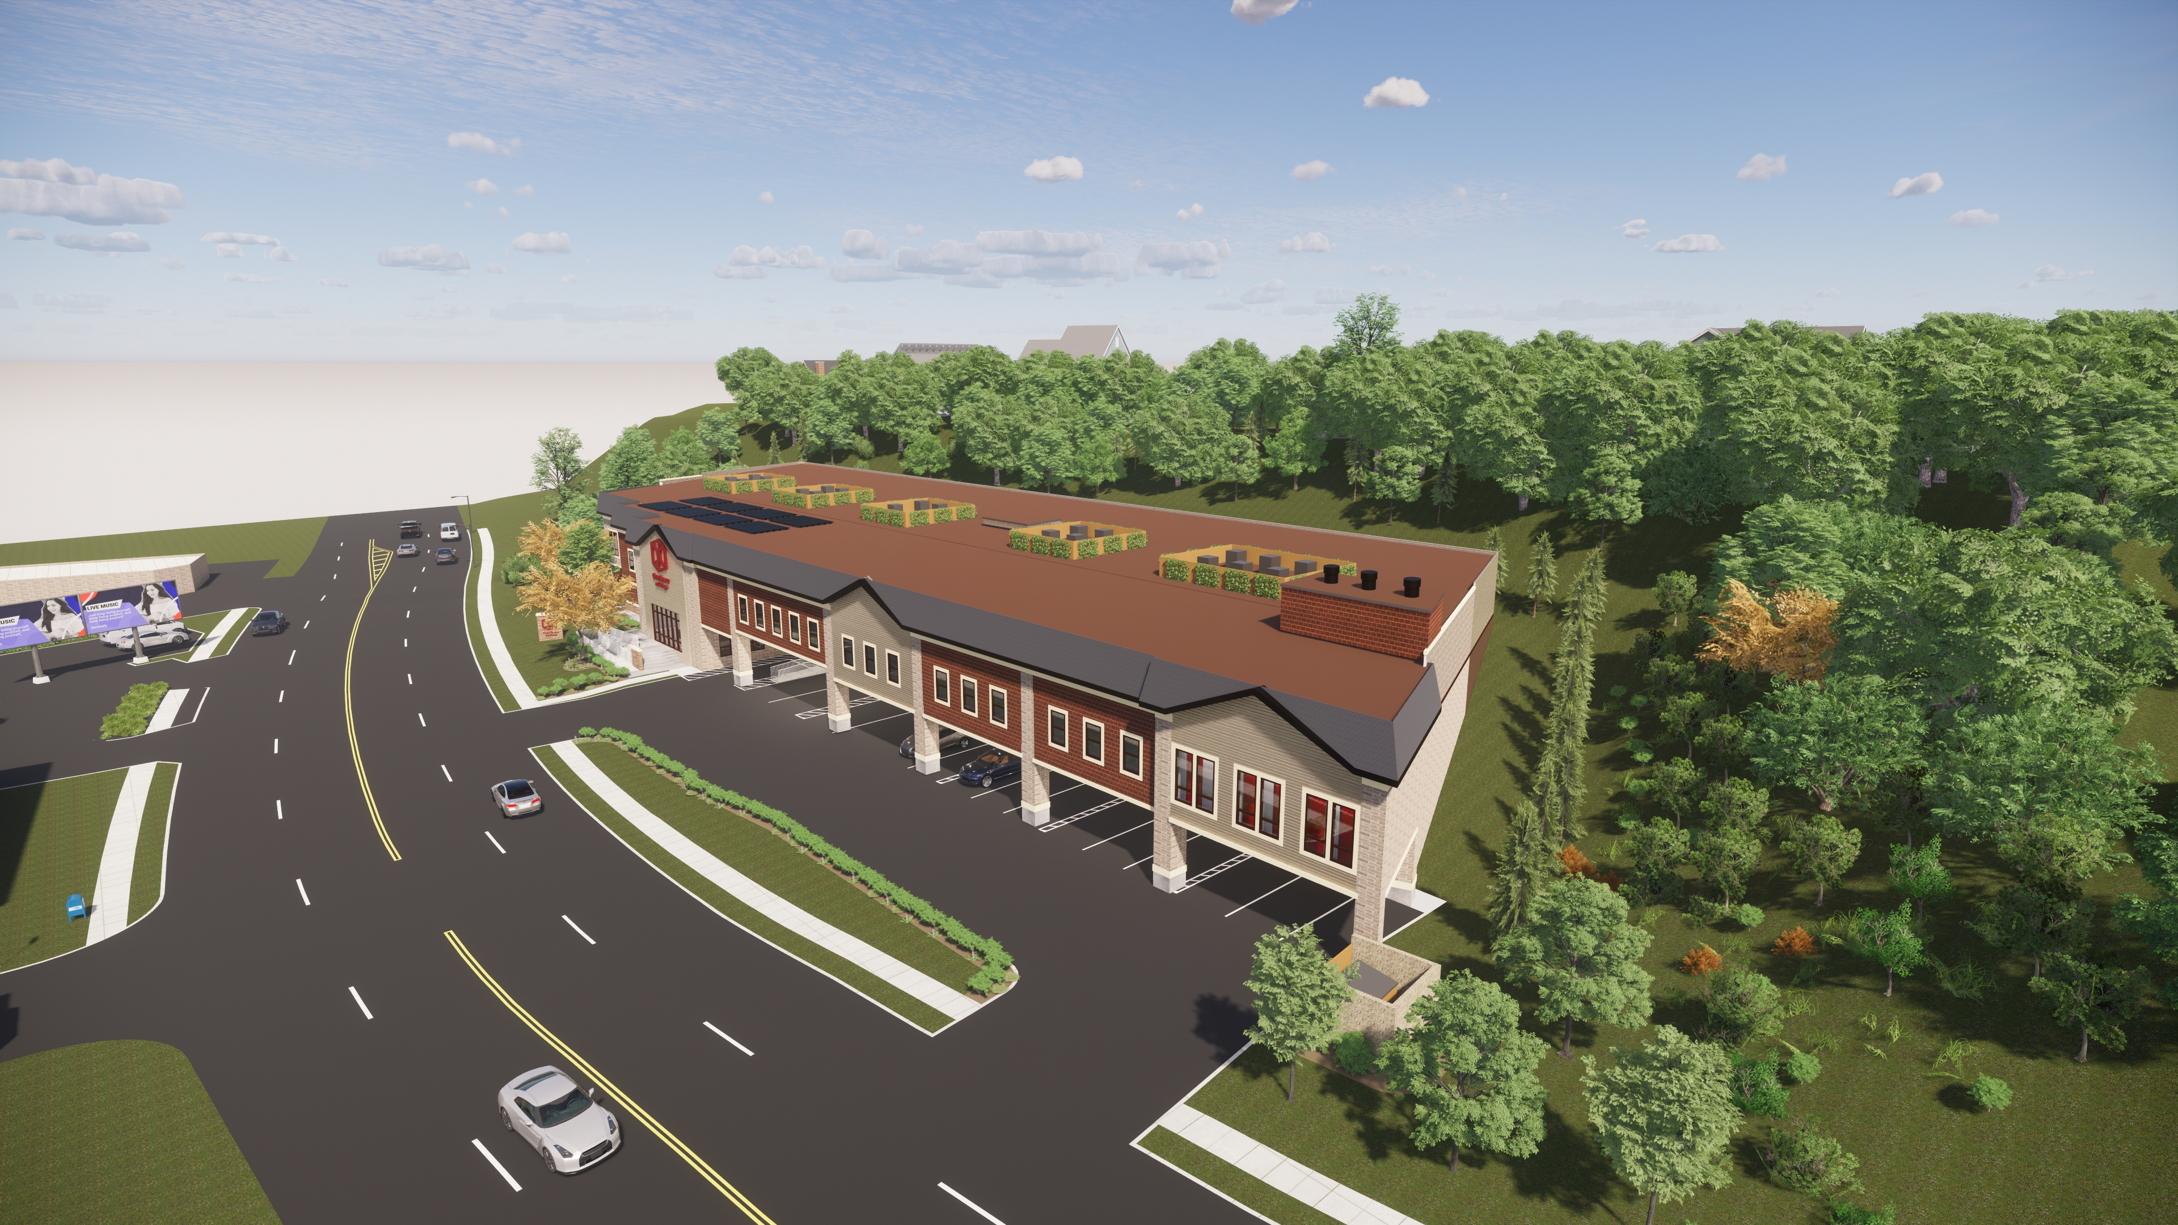
WEST ORANGE SELF STORAGE | ESSEX COUNTY, NJ
IMAGE 3
CONCEPTUAL DRAFT ONLY
Louis W Vandeloecht
Architect

