Slide 1

Capitol Seniors Housing
Development of an
Assisted Living Community In West Orange, New Jersey
Preliminary Investment Package
June 10, 2021
The information in this presentation is confidential unless expressly stated otherwise and should not be disclosed to any unauthorized third party, other than professional advisors or consultants, and is subject to change at any time. This presentation is addressed to a select number of potential investors, and does not constitute an offer to the public to subscribe for shares in an investment or company. No warranty or representation of any kind, whether express or implied, is given in relation to the information in this presentation and FS Partners shall not be liable for damages arising from any unauthorized or unlawful use of the information in this presentation.

Slide 2
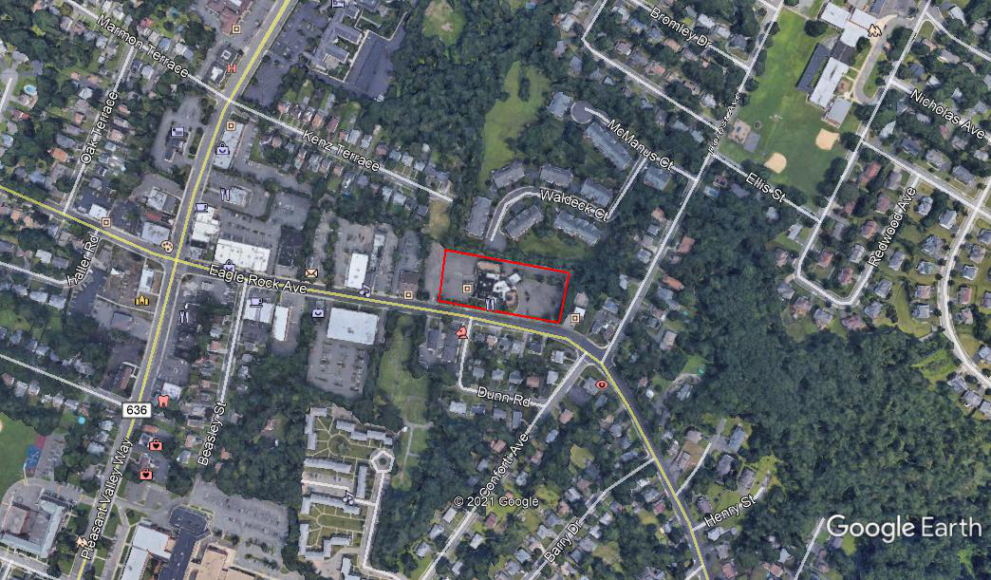
609 Eagle Rock Avenue

Slide 3
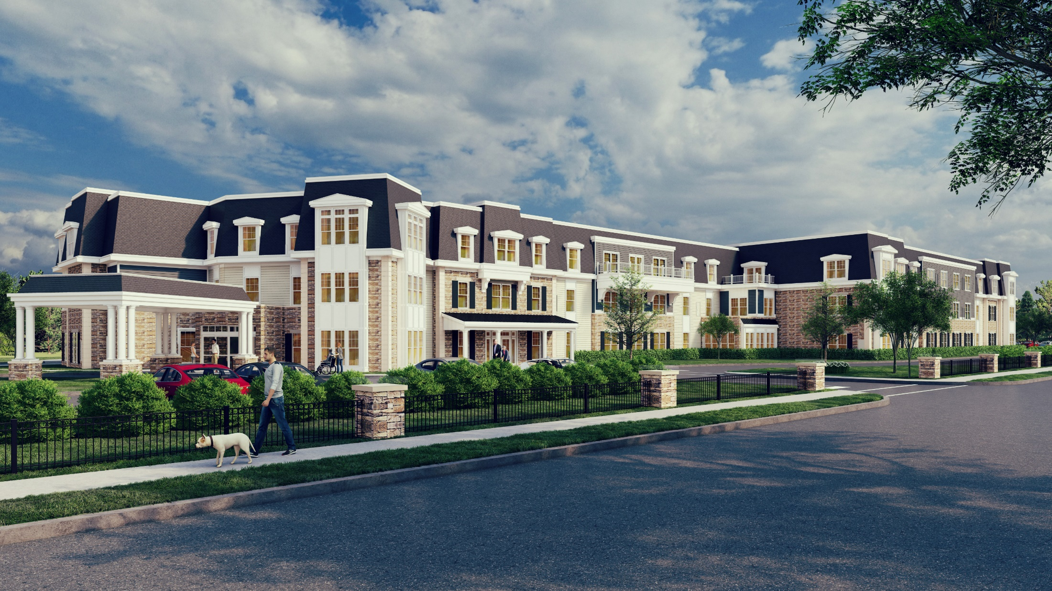

Slide 4
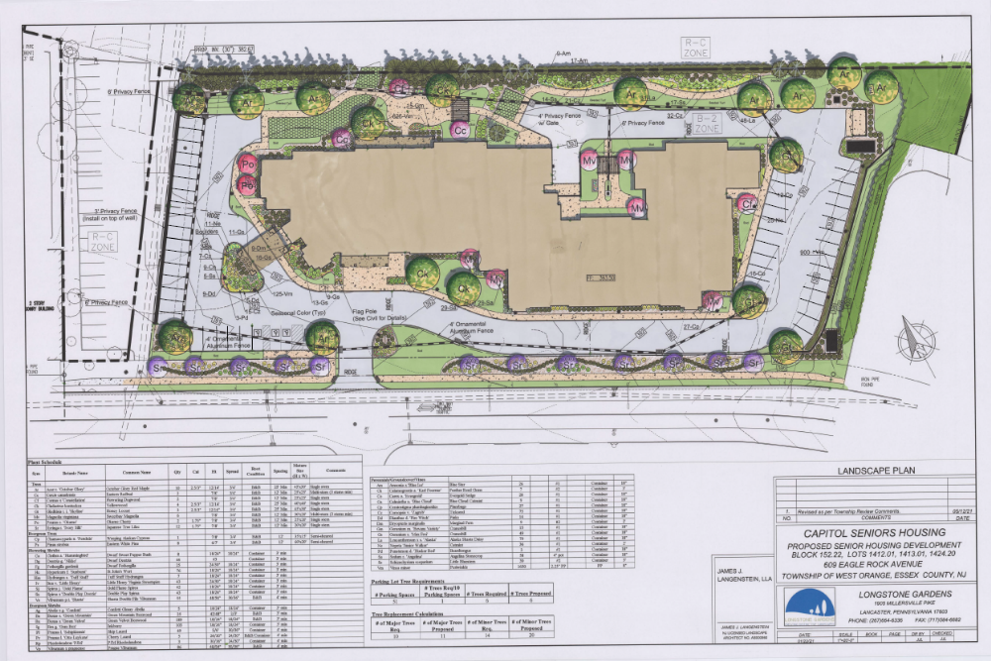

Slide 5
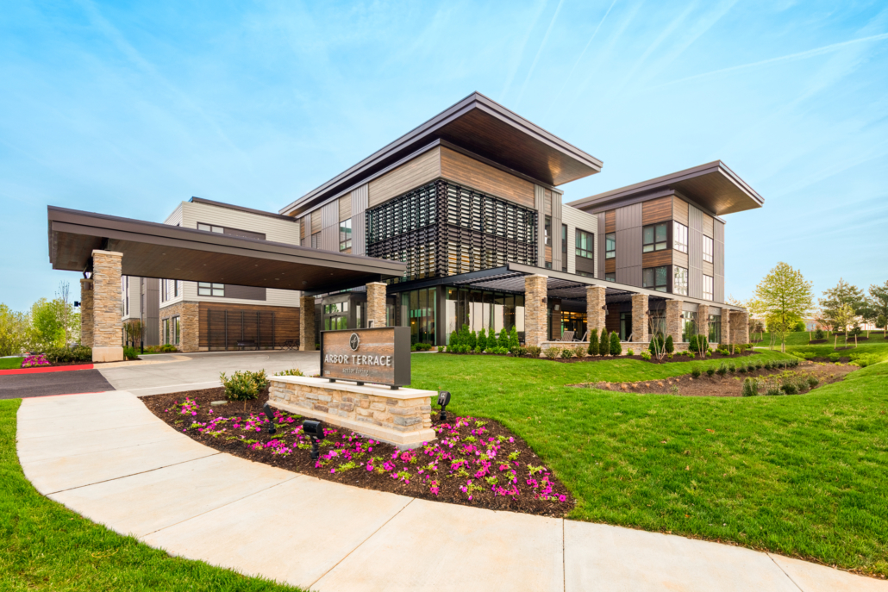
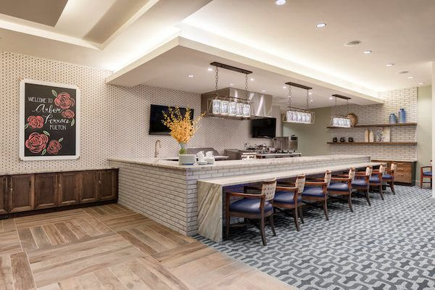
  Capitol Seniors Housing
  Introduction: Joseph F. McElwee – Principal, Development
  Sector Focus: Formed in 2003, CSH is a real estate private equity firm with an exclusive focus on seniors housing
  Experienced Team: Developed 150+ communities totaling more than 12,000 units in 30 years. More than 65 years of experience
    Philadelphia based development team has been together for nearly 25 years. Jim May, Dave Ennis, and Joe McElwee
  Full Spectrum Seniors Housing: Active Living, Independent Living, Assisted Living, and Memory Care
  Dedicated Equity: Backed by two of the largest private equity funds in the United States – Bain Capital and The Carlyle Group
  Arbor Terrace – Fulton, MD

Slide 6
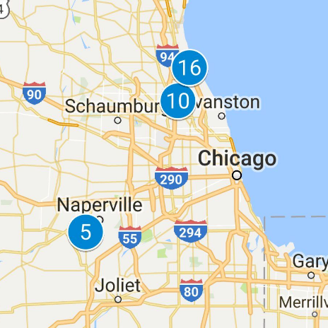
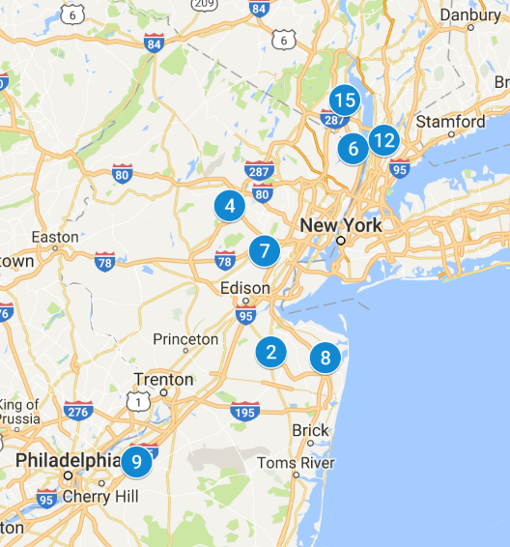
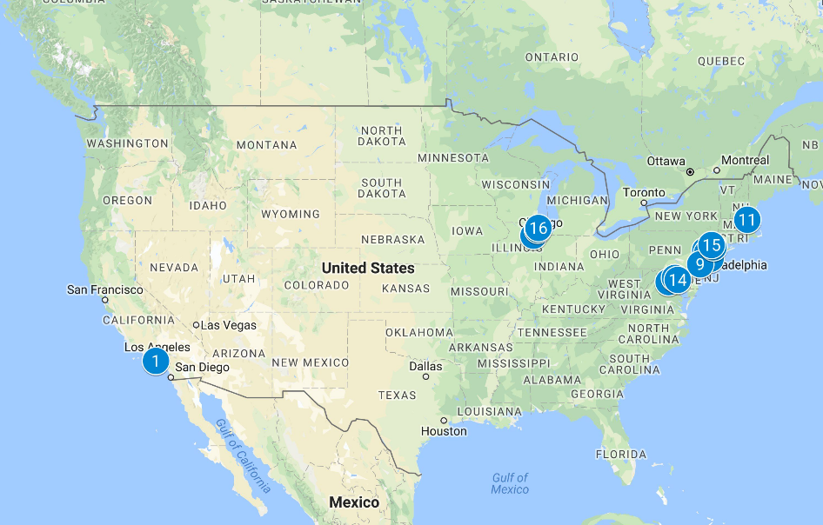
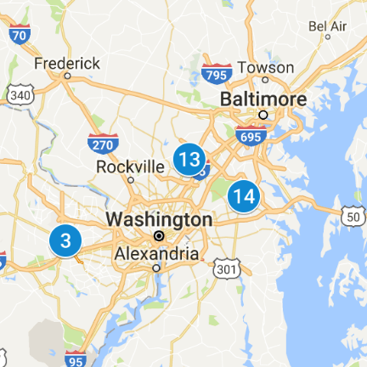
  National Development Footprint
 | Project | State | Acres | Product | Units | Lender
1 | Torrance | CA | 3.13 | AL / MC | 109 | Texas Capital
2 | Marlboro | NJ | 6.5 | AL /MC | 79 | Key Bank
3 | Fairfax | VA | 5.6 | MC | 48 | United Bank
4 | Morris Plains | NJ | 3.1 | AL / MC | 82 | Wells Fargo
5 | Naperville | IL | 7.11 | AL / MC | 95 | United Community Bank
6 | Norwood | NJ | 3.4 | AL / MC | 83 | Wells Fargo
7 | Mountainside | NJ | 1.8 | AL / MC | 79 | Wells Fargo
8 | Shrewsbury | NJ | 4.0 | AL / MC | 85 | M&T
9 | Mount Laurel | NJ | 6.0 | AL / MC | 88 | Lakeland Bank
10 | Glenview | IL | 4.0 | AL / MC | 83 | Wintrust
11 | Andover | MA | 10.31 | AL / MC | 96 | Wells Fargo
12 | Greenburgh | NY | 6.89 | AL / MC | 101 | M&T
13 | Maple Lawn | MD | 3.0 | AL / MC | 86 | United Bank
14 | Waugh Chapel | MD | 4.0 | AL / MC | 84 | United Bank
15 | New City | NY | 5.1 | AL / MC | 80 | M&T
16 | Highland Park | IL | 1.5 | AL / MC | 86 | Wintrust

Slide 7
  North Jersey Area Development
Atria Norwood Sunrise of Basking Ridge
Arbor Terrace Mountainside Sunrise of West Essex
Arbor Terrace Morris Plains Sunrise of Wayne
Arbor Terrace Roseland Sunrise of East Brunswick
Chelsea of Marlboro Sunrise of Morris Plains
Sunrise of Cresskill Sunrise of Madison
Sunrise of Old Tappan Sunrise of Jackson
Sunrise of Paramus Sunrise of Marlboro
Sunrise of Edgewater Sunrise of Wall
Sunrise of Woodcliffe Lake Sunrise of Lincroft
Sunrise of Randolph Sunrise of Morris Plain
Chelsea of Shrewsbury Chelsea Washington Twsp

Slide 8
Capitol Seniors Housing Proposal- General
Capitol Seniors Housing
85 unit assisted living residence licensed by the New Jersey Department of Health. There are 63 units of Assisted Living and 22 units of Memory Care. The Memory Care residents are in a secured wing and have access to a secured garden area protected with a 6’ fence.
CSH has applied for a 100 bed CON from the NJ Department of Health
Average age at entry for a typical assisted living resident is 86 years old
Residents are not able to live independently and are not candidates for skilled nursing care.
Assisted Living is licensed by NJDOH as an Assisted Living Residence
Nursing Homes are licensed by NJDOH as Long-Term Care Facilities
The residents do not drive.
Residents need help with Activities of Daily Living (Bathing, grooming, dressing, transportation, etc.)
There will be about 30 employees on the largest full-time shift (7-3), about 22 on 2nd shift (3-11) and about 4-5 employees over night (11-3)
The health care staffing consists of RN’s, LPN’s, Medication Managers, and Resident Assistants
Executive Director, Marketing, Activities, Dietary, Housekeeping, Receptionist, Office Manager

Slide 9
Capitol Seniors Housing Proposal-Building
Capitol Seniors Housing
The building is approximately 77,190 square feet in 3 stories
CSH has many different designs and we will build a design that is appropriate for West Orange and the neighbors
About 40% or 30,400 square feet is common space or back of house. Amenities include common dining areas, private dining, theatre, living rooms, bistro, hair salon, activity, seating areas, lounges and outdoor garden areas.
Units range in size from 350 SF Studios to 850 SF Two Bedroom units
The units are not “self contained” like a traditional housing unit. Units will have a refrigerator, counter tops, and cabinets
All residents will be served three meals per day in common dining areas throughout the community

Slide 10
Capitol Seniors Housing Proposal-Transportation
Capitol Seniors Housing
CSH will provide a 14-passenger van for the resident’s use
CSH will also contract with a private ambulance company for non-emergency transportation
The site plan provides approximately 51 parking spaces which is .60 spaces/unit
CSH estimates that at full occupancy there will be approximately two 911 calls per week. Not all of the 911 calls will require sirens
There will be approximately two food deliveries per week and two trash pick-ups per week. The deliveries and trash pick up will meet the ordinances of the Township

Slide 11
Why Assisted Living?
Capitol Seniors Housing
The fastest growing age segment of the population is 85+.
The second fastest growing age segment is 75+
The 65+ population is now 13% of the U.S. population
The 65+ population is expected to be 20% by 2050
In 2010, the number of people with Alzheimer’s disease was about 5,100,000
In 2050, the number of people with Alzheimer’s disease is projected to be 13,500,000.
“Silver Tsunami” – 10,000 people per day turn 65.
We have to prepare for the demographics which are certain

Slide 12
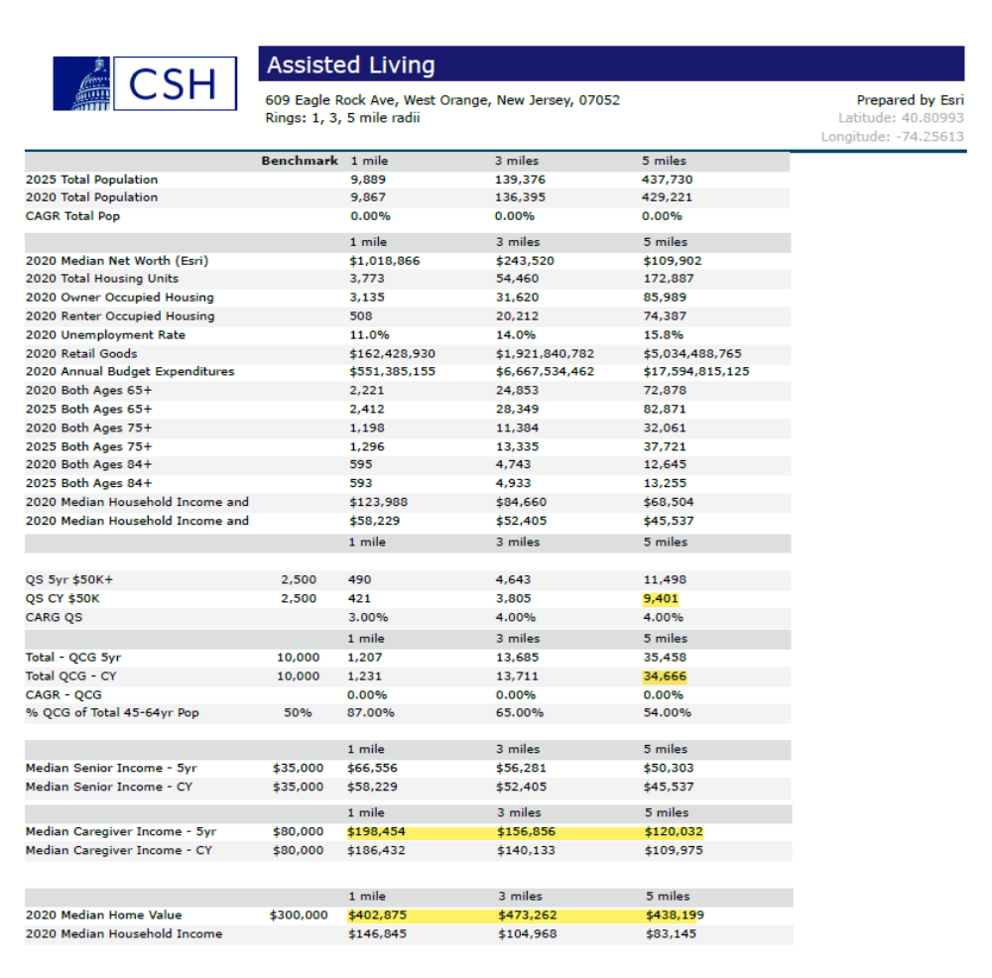
4. Demographics 2020 – 5 Mile

Slide 13
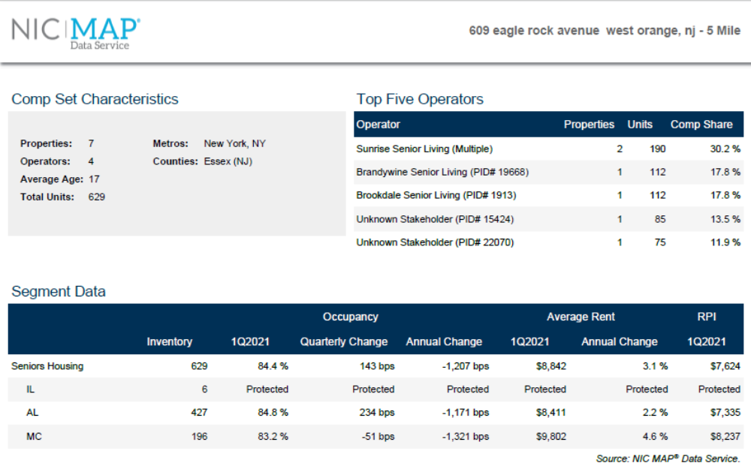
5. Market & Location Characteristics

Slide 14
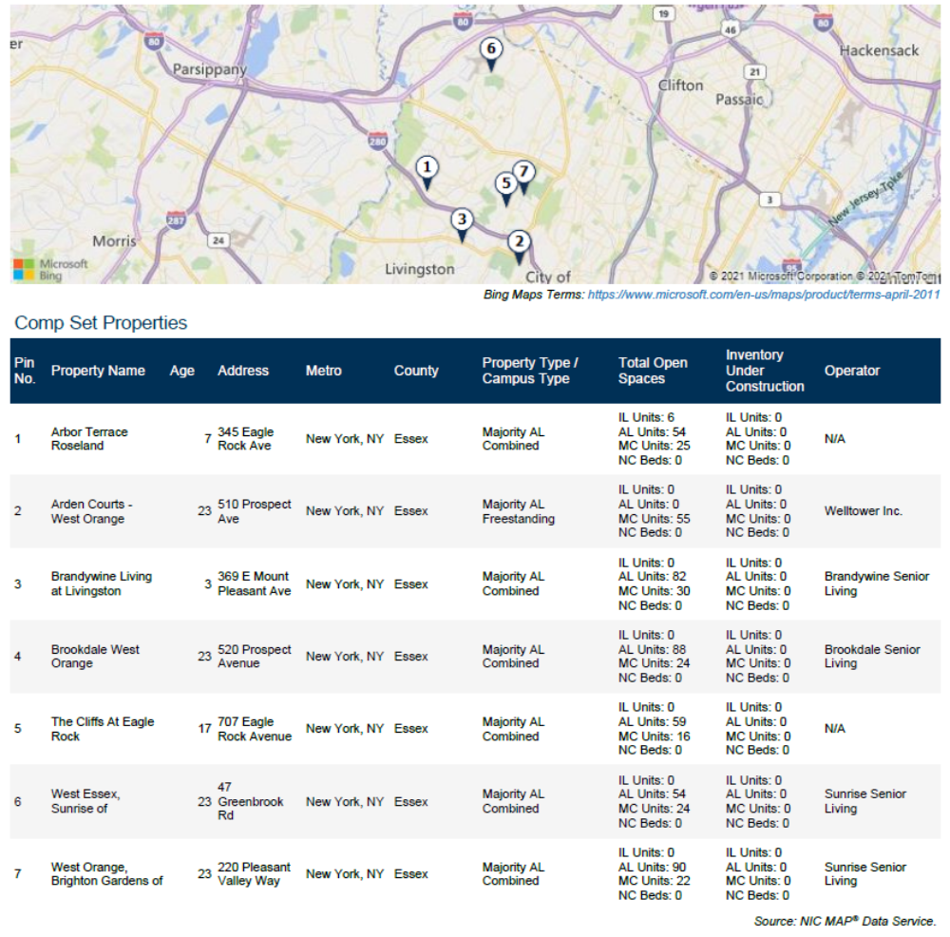
5. Market & Location Characteristics

Slide 15
6. Summary
A good use for the community
A reuse of the current vacant catering company
Tremendous demographics now and in the future
A good buffer of the residential to the rear and the commercial in front
Very low traffic generator
10 Medicaid beds and 10 COAH units for West Orange
No impact on the school system
A for-profit property tax use

