Slide 1
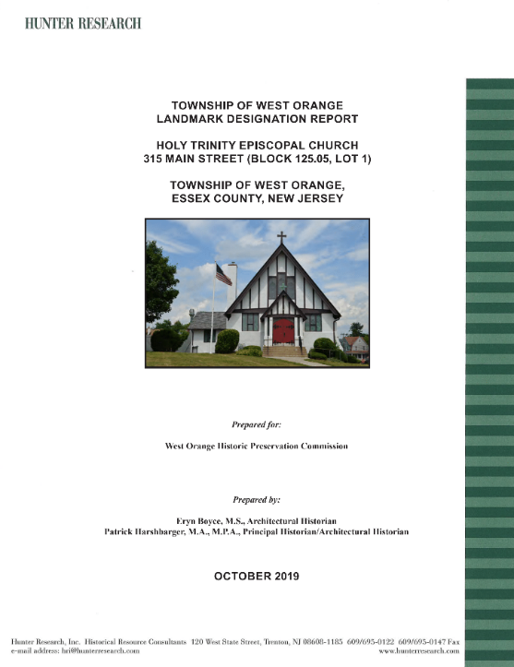

Slide 2
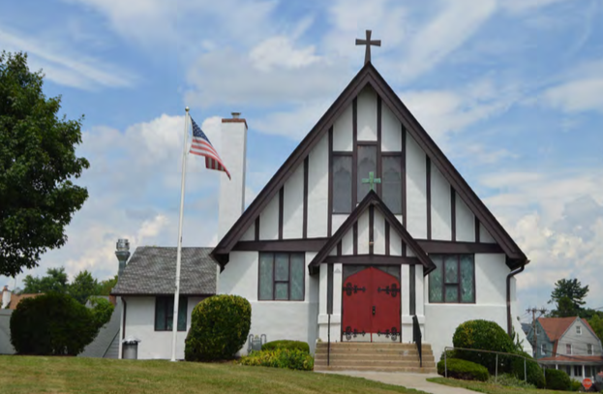
Holy Trinity Episcopal Church (1907)
Architect: Hobart Brown Upjohn
Noteworthy exterior characteristics:
Tudor Revival style
  Half timbering
  Buttresses
Stucco-covered load-bearing hollow structural clay tile block construction

Slide 3
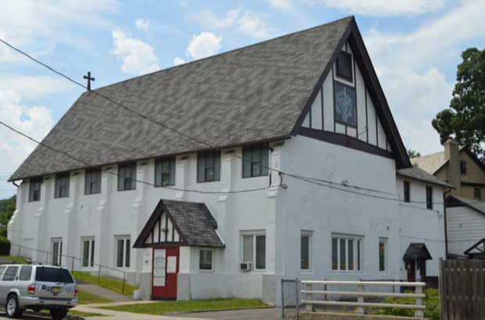
Holy Trinity Episcopal Church (1907)
Architect: Hobart Brown Upjohn
Noteworthy exterior characteristics:
Tudor Revival style
  Half timbering
  Buttresses
Stucco-covered load-bearing hollow structural clay tile block construction

Slide 4
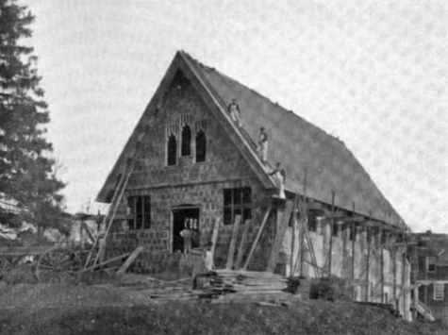
Holy Trinity Episcopal Church (1907)
Architect: Hobart Brown Upjohn
Noteworthy exterior characteristics:
Tudor Revival style
  Half timbering
  Buttresses
Stucco-covered load-bearing hollow structural clay tile block construction

Slide 5
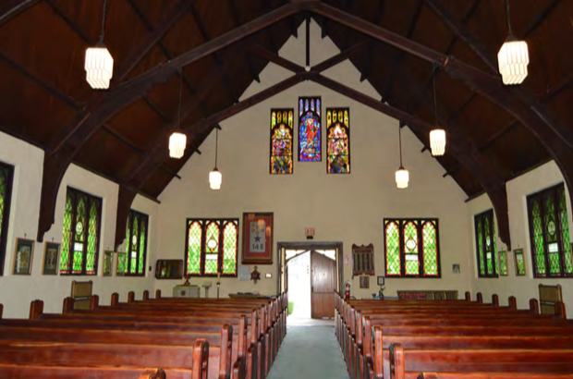
Holy Trinity Episcopal Church (1907)
Architect: Hobart Brown Upjohn
Noteworthy interior characteristics:
Exposed timber roof trusses
Carved timber choir
Original stained and leaded glass windows

Slide 6
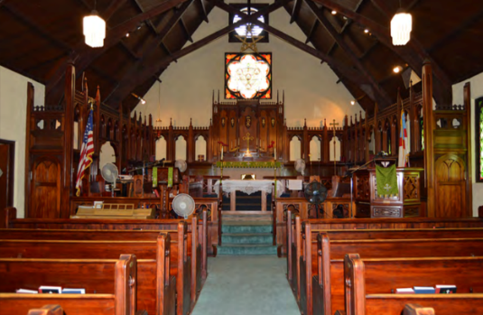
Holy Trinity Episcopal Church (1907)
Architect: Hobart Brown Upjohn
Noteworthy interior characteristics:
Exposed timber roof trusses
Carved timber choir
Original stained and leaded glass windows

Slide 7
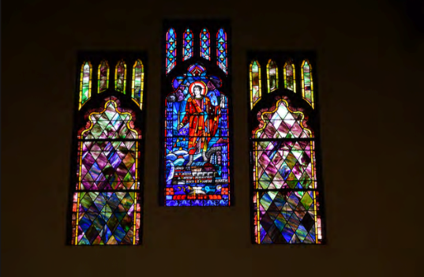
Holy Trinity Episcopal Church (1907)
Architect: Hobart Brown Upjohn
Noteworthy interior characteristics:
Exposed timber roof trusses
Carved timber choir
Original stained and leaded glass windows

Slide 8
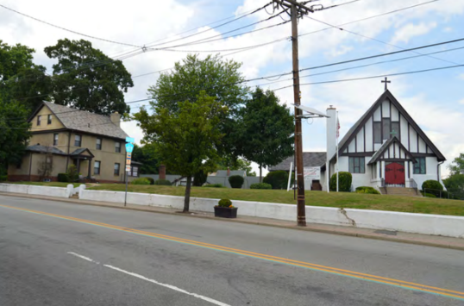
Holy Trinity Episcopal Church (1907)
History
Separated from St. Mark’s parish in 1905
Served residents of the Tory Corner neighborhood
Architect designed, built by volunteer parishioners
Parsonage and Garage (c. 1924-32), and Community Center (1954)

Slide 9
Holy Trinity Episcopal Church (1907)
Significance for Landmark Status
Eligible under Criterion C as a unique combination of architect design and vernacular volunteer-built construction
Criterion C: a property that embodies the distinctive characteristic of a type, period or method of construction, or that represent the work of a master, or that possess high artistic values

Slide 10
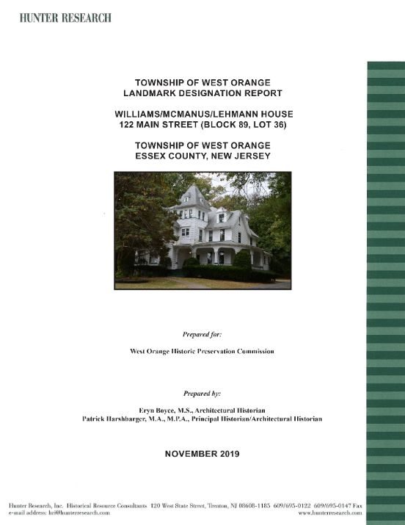

Slide 11
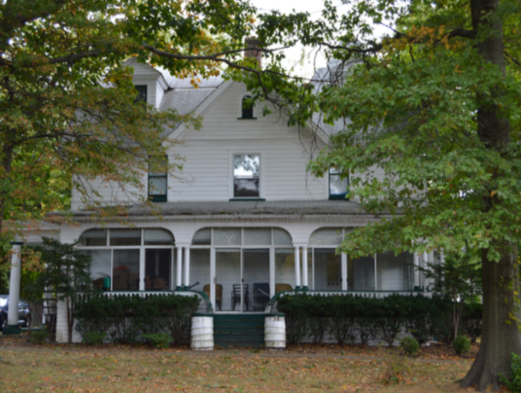
Williams/McManus/Lehmann House (1856-57, remodeled 1895-96)
Noteworthy exterior characteristics:
Italianate style
Cross gable with arched dormer window

Slide 12
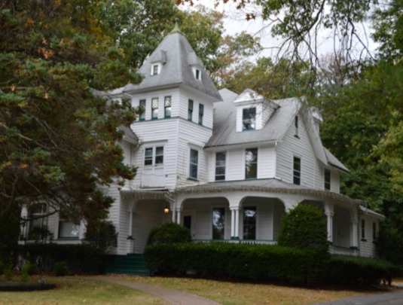
Williams/McManus/Lehmann House (1856-57, remodeled 1895-96)
Noteworthy exterior characteristics:
Queen Anne style
Asymmetrical massing
Varied roof line
Tower with ball finial
Varied fenestration pattern
Multiple porches

Slide 13
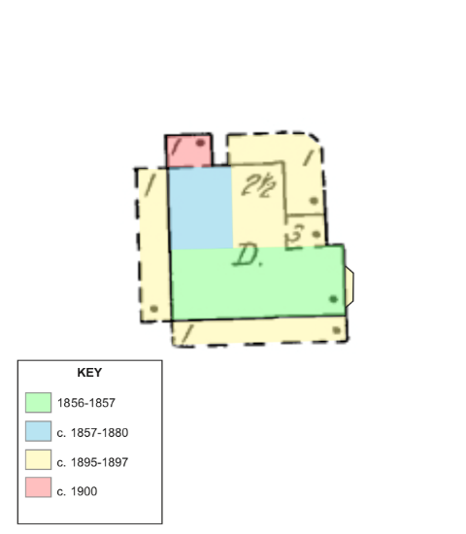
Williams/McManus/Lehmann House (1856-57, remodeled 1895-96)
Noteworthy characteristics:
Multiple Phases of Development

Slide 14
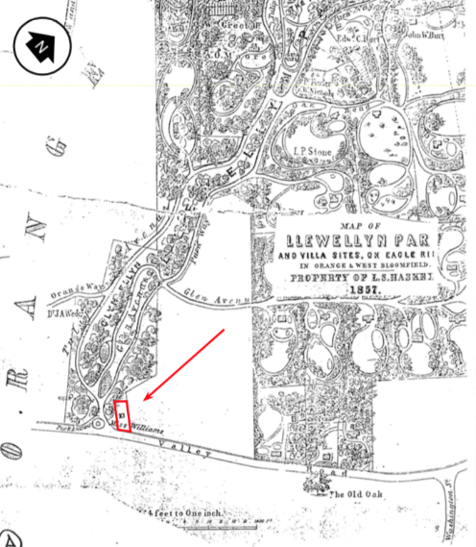
Williams/McManus/Lehmann House (1856-57, remodeled 1895-96)
History
Constructed in 1856-57 for Margaret Williams, granddaughter of Tory Corner loyalist Benjamin Williams and sister of St. Mark’s rector James Williams
Located on a 1-acre lot subdivided from Llewellyn Haskell’s Llewellyn Park, next to main entrance
Original house oriented to entrance to Llewellyn Park
Likely an Italianate cottage influenced by architect Andrew Jackson Downing

Slide 15
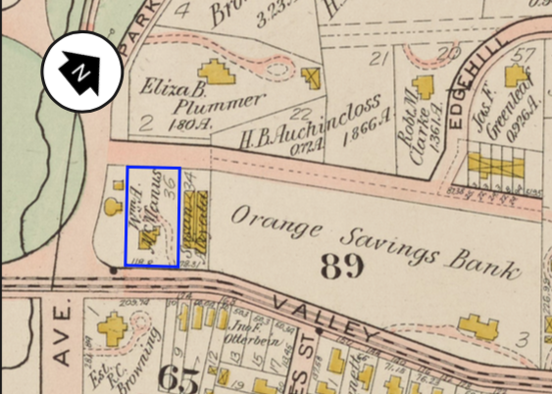
Williams/McManus/Lehmann House (1856-57, remodeled 1895-96)
History
Remodeled and enlarged in the Queen Anne style and purchased in 1897 by Newark leather merchant William A. McManus
One of six comparable Queen Anne-style houses associated with Llewellyn Park development
Occupied by Charles J. and Josephine Lehmann from 1913 to 1965

Slide 16

Williams/McManus/Lehmann House (1856-57, remodeled 1895-96)
Significance for Landmark Status
Eligible under Criterion A for its historic association with the development of Llewellyn Park
Criterion A : a property that is associated with events that have made a significant contribution to the broad patterns of our history

Slide 17

Williams/McManus/Lehmann House (1856-57, remodeled 1895-96)
Significance for Landmark Status
Eligible under Criterion C for architectural distinction as a Queen Anne-style residence made more complex by its incorporation of a mid-19th-century revival style house, which began in the picturesque style of Andrew Jackson Downing. Reflects more ornate architectural tastes of the Gilded Age
Criterion C: a property that embodies the distinctive characteristic of a type, period or method of construction, or that represent the work of a master, or that possess high artistic values

Slide 18
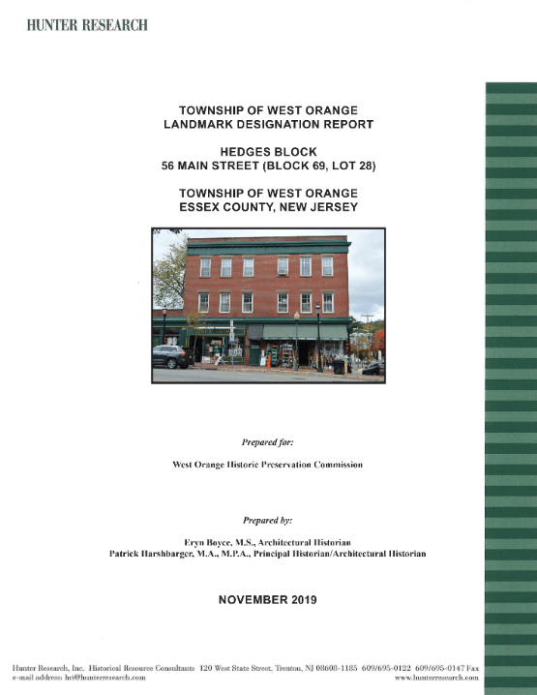

Slide 19
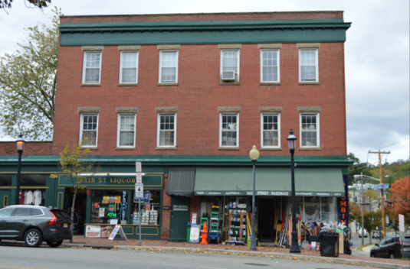
Hedges Block (1892)
Noteworthy exterior characteristics:
Late-19th-c. commercial “main street” style
Flat roof, brick parapet, wood cornice
Brick quoining pattern
Division between two storefronts and upper stories
Windows with stone lintels/sills
Painted advertising
Wedge-shaped floor plan to conform to corner of Valley Road and Lindsley Street
Loading dock door

Slide 20
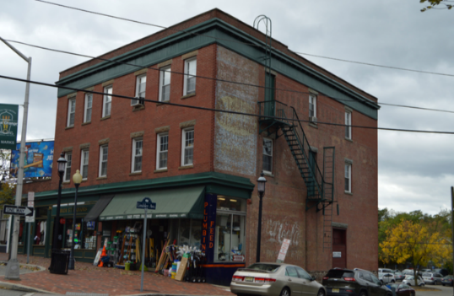
Hedges Block (1892)
Noteworthy exterior characteristics:
Late-19th-c. commercial “main street” style
Flat roof, brick parapet, wood cornice
Brick quoining pattern
Division between two storefronts and upper stories
Windows with stone lintels/sills
Painted advertising
Wedge-shaped floor plan to conform to corner of Valley Road and Lindsley Street
Loading dock door

Slide 21
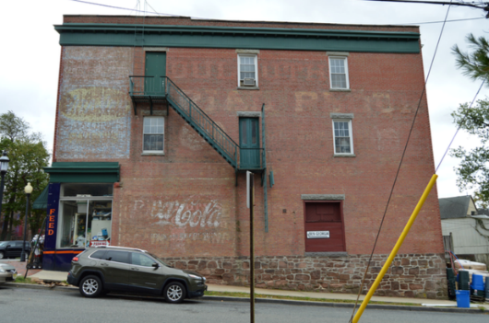
Hedges Block (1892)
Noteworthy exterior characteristics:
Late-19th-c. commercial “main street” style
Flat roof, brick parapet, wood cornice
Brick quoining pattern
Division between two storefronts and upper stories
Windows with stone lintels/sills
Painted advertising
Wedge-shaped floor plan to conform to corner of Valley Road and Lindsley Street
Loading dock door

Slide 22
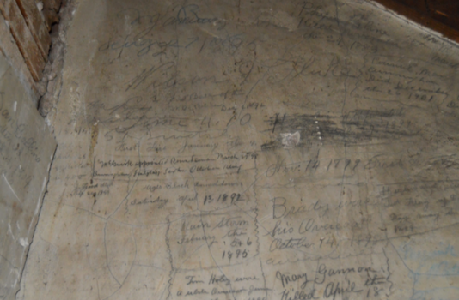
Hedges Block (1892)
Noteworthy interior characteristics:
Pressed tin ceilings
Plaster walls
Wood plank floors
Graffiti in stairwell

Slide 23
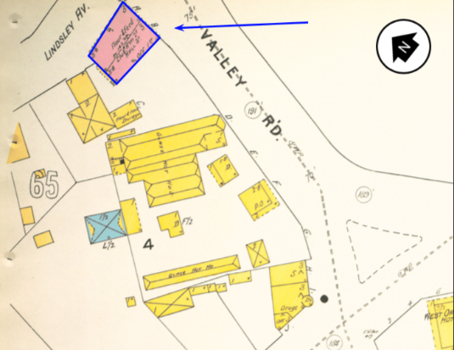
Hedges Block (1892)
History
Built in 1892 to replace the first “Hedges Block,” which was destroyed by fire
Samuel M. Hedges, flour, feed and grain dealer
Rented upper stories to West Orange Township, which used space as fire, police and clerk’s office until 1905

Slide 24
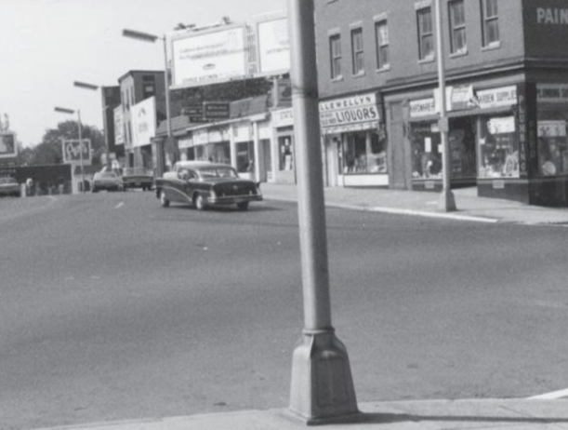
Hedges Block (1892)
History
Became the Smith & Kaufman hardware store in 1940
Many tenants over the years:
  Eagle Rock Council Lodge
  Central Dress Co.
  Lambrew produce store
  Wallman & Lehrer plumbers
  Main Street liquors

Slide 25

Hedges Block (1892)
Significance for Landmark Status
Eligible under Criterion C as one of the oldest and best preserved commercial buildings on West Orange’s Main Street corridor. It embodies the character-defining features of late-19th-century vernacular commercial architecture.
Criterion C: a property that embodies the distinctive characteristic of a type, period or method of construction, or that represent the work of a master, or that possess high artistic values

Slide 26
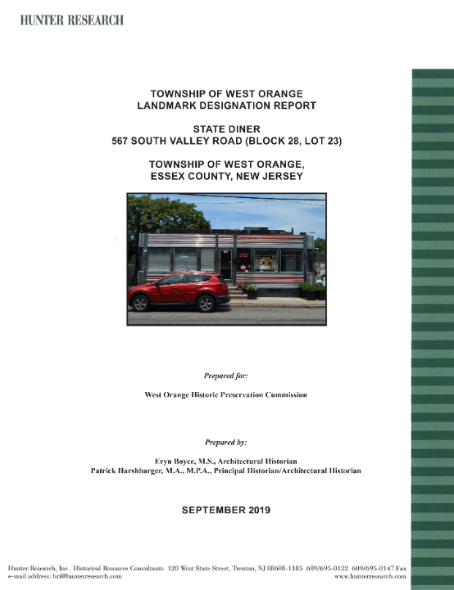

Slide 27
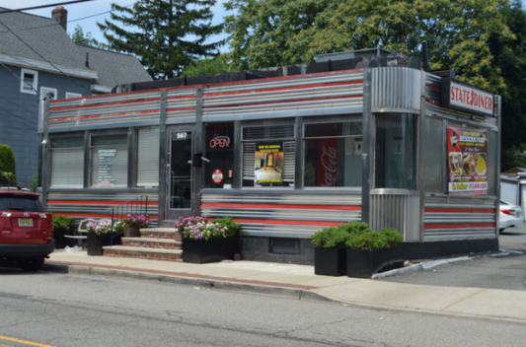
State Diner (ca. 1947)
Noteworthy exterior characteristics:
Prefabricated dining car
Streamlined Art Moderne style
  Horizontal ribs
  Vertical ribs
  Curved corners
Pressed stainless steel and plate glass

Slide 28
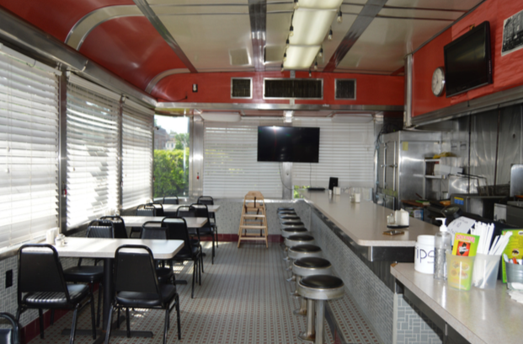
State Diner (ca. 1947)
Noteworthy interior characteristics:
Railroad car style ceiling
Open single dining room
Counter with stools
Stainless steel “back bar”
Ceramic tile finishes

Slide 29
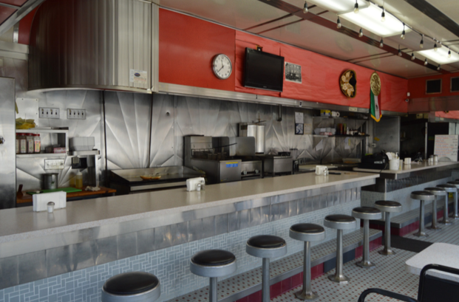
State Diner (ca. 1947)
History
Built by the Kullman Dining Car Company, Harrison, NJ
Smaller size diner marketed as a “dinette”
Joseph Lombritto established diner at this location ca. 1928
His son, Frank Lombritto replaced the original diner ca. 1947 with this one

Slide 30
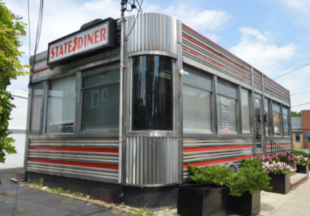
State Diner (ca. 1947)
Significance for Landmark Status
Eligible under Criterion C as embodying the character-defining features of the streamlined Art Moderne diner property type. This quintessential American architecture turned New Jersey into the “diner capital” and enabled immigrants and working-class Americans to become independent business owners.
Criterion C: a property that embodies the distinctive characteristic of a type, period or method of construction, or that represent the work of a master, or that possess high artistic values

Slide 31
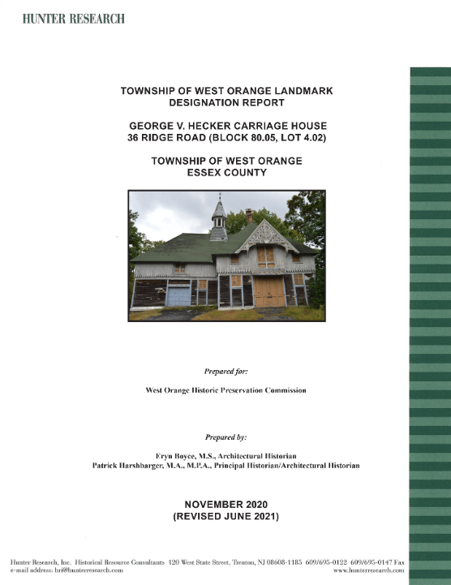

Slide 32
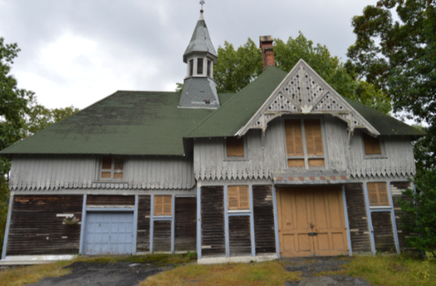
George V. Hecker Carriage House (1866-67)
Architect: Henry Hudson Holly
Noteworthy exterior characteristics
Multi-directional hip-on-cross-gable roof
Overhanging eaves with decorative rafters
Octagonal ventilator (cupola)
Tripartite brick chimney
Varied siding (clapboards, board-and-batten, stick work)
Plan of first-floor carriage room and horse stable, second-floor hayloft and quarters for grooms/carriage men

Slide 33
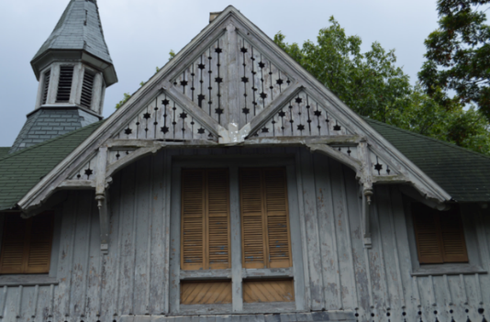
George V. Hecker Carriage House (1866-67)
Architect: Henry Hudson Holly
Noteworthy exterior characteristics
Multi-directional hip-on-cross-gable roof
Overhanging eaves with decorative rafters
Octagonal ventilator (cupola)
Tripartite brick chimney
Varied siding (clapboards, board-and-batten, stick work)
Plan of first-floor carriage room and horse stable, second-floor hayloft and quarters for grooms/carriage men

Slide 34
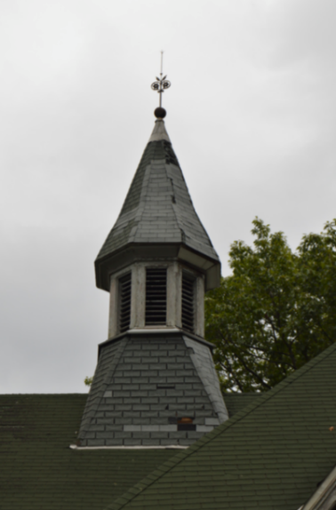
George V. Hecker Carriage House (1866-67)
Architect: Henry Hudson Holly
Noteworthy exterior characteristics
Multi-directional hip-on-cross-gable roof
Overhanging eaves with decorative rafters
Octagonal ventilator (cupola)
Tripartite brick chimney
Varied siding (clapboards, board-and-batten, stick work)
Plan of first-floor carriage room and horse stable, second-floor hayloft and quarters for grooms/carriage men

Slide 35
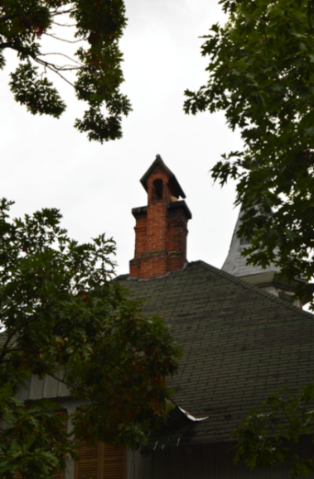
George V. Hecker Carriage House (1866-67)
Architect: Henry Hudson Holly
Noteworthy exterior characteristics
Multi-directional hip-on-cross-gable roof
Overhanging eaves with decorative rafters
Octagonal ventilator (cupola)
Tripartite brick chimney
Varied siding (clapboards, board-and-batten, stick work)
Plan of first-floor carriage room and horse stable, second-floor hayloft and quarters for grooms/carriage men

Slide 36
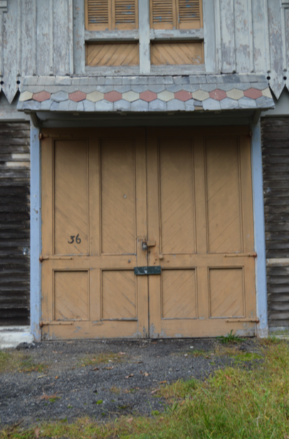
George V. Hecker Carriage House (1866-67)
Architect: Henry Hudson Holly
Noteworthy exterior characteristics
Multi-directional hip-on-cross-gable roof
Overhanging eaves with decorative rafters
Octagonal ventilator (cupola)
Tripartite brick chimney
Varied siding (clapboards, board-and-batten, stick work)
Plan of first-floor carriage room and horse stable, second-floor hayloft and quarters for grooms/carriage men

Slide 37
George V. Hecker Carriage House (1866-67)
Architect: Henry Hudson Holly
Noteworthy exterior characteristics
Multi-directional hip-on-cross-gable roof
Overhanging eaves with decorative rafters
Octagonal ventilator (cupola)
Tripartite brick chimney
Varied siding (clapboards, board-and-batten, stick work)
Plan of first-floor carriage room and horse stable, second-floor hayloft and quarters for grooms/carriage men

Slide 38
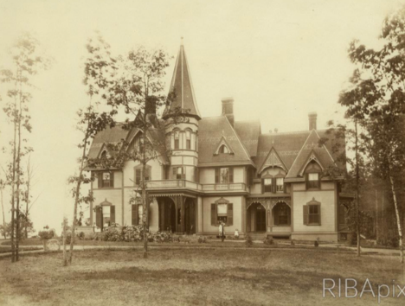
George V. Hecker Carriage House (1866-67)
History
George V. Hecker, made fortune as a flour miller in Brooklyn
Purchased 13 acres in West Orange in 1866 for a country house “Rockwood” in the exclusive Mountain Ridge neighborhood
Henry Hudson Holley hired as architect. Considered the “father” of the Queen Anne style
Stick-style carriage house designed to complement the main house

Slide 39
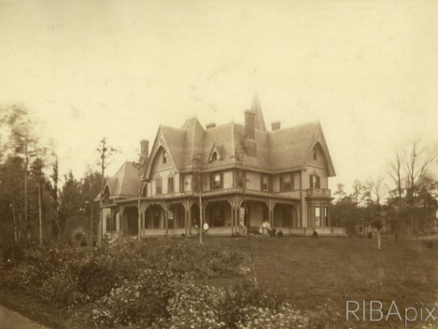
George V. Hecker Carriage House (1866-67)
History
Country house destroyed by fire in 1883
New stone dwelling “East Clive” built by Josephine Mary Hecker Slevin and Edward Purcell Slevin
Slevins were active in the development of the Essex County Club
East Clive demolished in 1948
Carriage house a remarkable survival. Largely unaltered and never rehabilitated for alternative uses

Slide 40

George V. Hecker Carriage House (1866-67)
Significance for Landmark Status
Eligible under Criterion C as an early and architecturally significant example of a Stick-style carriage house by a master architect.
Criterion C: a property that embodies the distinctive characteristic of a type, period or method of construction, or that represent the work of a master, or that possess high artistic values

